Slide 1
“An Airway to be Mindful of” Summary Slides EMS Conference Rusustsu 2019
Dr Anand Senthi
MBBS, MAppFin, GradCertPubHlth, FRACGP, FACEM
@drsenthi

Slide 2
Airway in Facial Trauma
https://lifeinthefastlane.com/ccc/airway-in-facial-trauma/

Slide 3
Cricothryotomy (CT) – level of preparedness
Considered awake pre-emptive CT (e.g. cannula +/- wire)
Versus
Preparing for this as a backup option only
Which CICO (Can’t Intubate, Can’t Oxygenate) status are you at?
If require CT
Cannula v Scalpel?

Slide 4
Source: emcrit.org

Slide 6
Scalpel CT: Competing Techniques
1. Scalpel-Bougie
2. Scalpel-Finger-Bougie
My recommendation based on training and some evidence
3. Scalpel-Finger Tube
Published case series by Australian retrieval doctors

Slide 7
What about the LMA?
2 options to consider:
1) “Rapid Sequence Airway (RSA)”
?? preferred strategy in pre-hospital arena
2) Rescue LMA

Slide 8
Suctioning Considerations
Double suction via CMAC
V’s
Meconium aspirator
Meconium aspirator may provide better suction than single yankauer sucker particularly when clots involved or heavy bleeding.
Meconium aspirator may be the more optimal choice when have solo airway operator (e.g. pre-hospital)

Slide 9
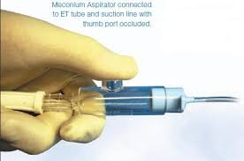

Slide 10
Other considerations
Use video laryngoscope with separate screen e.g. CMAC. Benefits:
Maximise chance of obtaining a view
Team approach to the airway
Double suction by other team members
Team leader and cricothyrotomy person able to visualize intubation progress/success
Need bright light for best view in bloody airway
E.g. CMAC and LED disposable laryngoscopes

Slide 11
Mental Training for Resuscitation

Slide 12
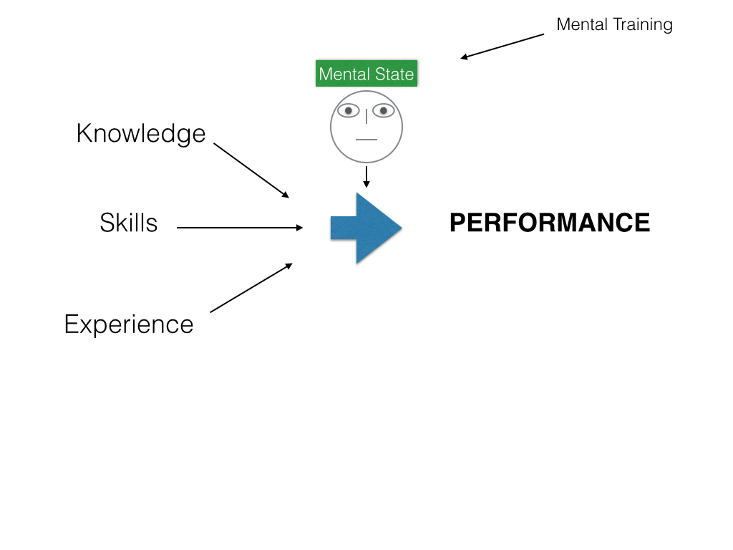

Slide 13
Grossman Stress Model Colour Codes

Slide 14
Skill deterioration
Tunnel Vision/Auto Pilot

Slide 15
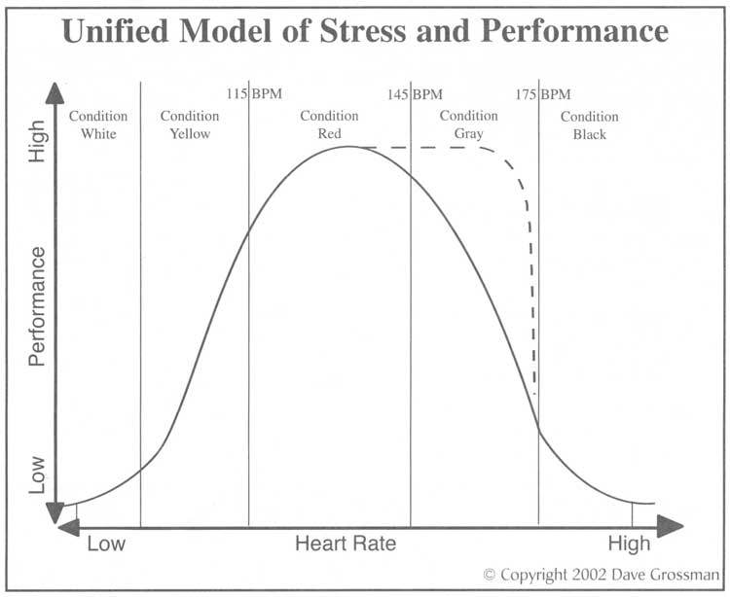

Slide 16
Threat v Challenge Appraisal
The level of experienced stress arousal that occurs when confronted with a demanding or difficult situation depends on mental appraisal as a Threat v Challenge
Lazarus & Folkman 1994 Stress Model
This depends on the perceived coping resources v the perceived situational demands
Demands > Resources = Threat
Resources > Demands = Challenge

Slide 17
Threat v Challenge Appraisal
Threat Appraisal → Fight or Flight stress response … with cortisol secretion leading to the colour coded stress levels above
Mental training is, in part, about training the mind to be able to make the Challenge appraisal instead of the Threat appraisal

Slide 18
Annals of Emergency Medicine 2017

Slide 19
PEPS
Performance Enhancing Psychological Skills
Breathe
Talk
See
Focus

Slide 20
Timing
Strategies can be used at different times with respect to the stressful moment
Before the moment
In the moment
After the moment

Slide 21
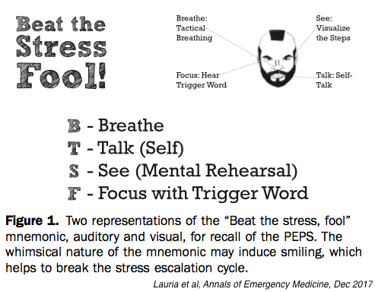

Slide 22
Podcasts & Further Information

Slide 23
Further information
Summary Post of below podcasts
http://www.emergucate.com/2017/01/22/foam-eye-catchers-13-mental-training-for-resuscitaiton/
Jason Brooks – Performance Psychology for the Resuscitationist
https://www.smacc.net.au/2015/12/performance-psychology-for-resuscitationists-jason-brooks/
Mike Mallin – The Day I Didn’t Use Ultrasound
https://emcrit.org/racc/day-i-didnt-use-ultrasound/
Scott Weingart – Kettlebells for the Brain
https://emcrit.org/racc/kettlebells-brain/

Slide 24
Performance Psychology for the Resuscitationist – Jason Brooks
Lessons from the field of Performance Psychology in elite athletes applied to critical care
https://www.smacc.net.au/2015/12/performance-psychology-for-resuscitationists-jason-brooks/

Slide 25
The Day I Didn’t Use Ultrasound – Mike Mallin
https://emcrit.org/racc/day-i-didnt-use-ultrasound/
Discusses rationale for mental strategies in resuscitation and a case where he needed them
Title originates from the fact that Mike Mallin is primarily known as an ultrasound guru

Slide 26
The Fog of War – Chris Hicks
Discussion of mental training techniques and rationale in critical care by a resuscitationist and trauma team leader conducting research in this area.
https://emcrit.org/racc/chris-hicks-fog-of-war/

Slide 27
Kettlebells for the Brain – Scott Weingart
Scott Weingart – Kettlebells for the Brain
https://emcrit.org/racc/kettlebells-brain/
Discussion regarding the use of meditation to improve mental function/focus/wellbeing for doctors
Scott Weingart is the well known author of the critical care blog/podcast emcrit.org

Slide 28
Mental Training For Resusctation
http://www.emergucate.com/2017/01/22/foam-eye-catchers-13-mental-training-for-resuscitaiton/
Post I wrote that briefly summarises learning points from the above podcasts.
Separates strategies that can be employed in a temporal fashion
Before, during and after the stressful moment
Note this was written before the seminal Annals of EM article came out with the “Beat The Stress Fool - Breathe, Talk, See Focus” approach

Slide 29
EDguidelines.com
EDguidelines.com
Unrelated to this talk, this site will also likely be of great use to the EMS attendees.
A site I created - free collection of useful ED guidelines and resources.

Slide 30
Disclaimer
The slides provide a brief summary of the talk and must be considered in combination with the explanation provided at the talk. They are not designed to be used alone
Doctors should not rely solely on this information and should independently investigate the information provided within this presentation
This information is of a general nature and individual patient characteristics must be taken into account if seeking to apply it
If in any doubt, seek senior/specialist clinical assistance

